Slide 1
Sprint 4
Sebastien Reed Gavin Kinsella Collin Gavin

Slide 2
Challenges
Uneven Floor
Tape border
Sprint 1: Having the robot stop, and turn when required
Sprint 2: Having the robot shift the axis to form the figure 8.
Sprint 3: Having the robot jump the binder and stop at the proper spot.

Slide 3
Team Member Roles
Sebastien Reed | Requirements Table, Block Code, Sensor Data, Staffing Planning
Gavin Kinsella | Requirements table, Algorithm, Test Table, GitHub Repository
Collin Gavin | Flow Chart, System Design Document, Robot Video

Slide 4
What we learned about Software Engineering
Requirements
Design
Collaboration and Communication
Persistence and Flexibility
Notes:
Requirements: Comprehensive understanding and documentation of project requirements before commencing work.
Design: Establishing a robust foundation through meticulous planning and architectural considerations.
Testing: Enforcing rigorous testing protocols across the entire development lifecycle.
Collaboration and Communication: Facilitating effective communication among team members.
Persistence and Flexibility: Acknowledging that not all tasks must be perfected on the initial attempt; allowing time for refinement and adaptation.

Slide 5
What would we do differently
In summary, the outcome surpassed our expectations. We successfully produced all three videos in a single evening (10/28), and maintaining excellent communication and meeting all anticipated objectives without issue.
The project was effectively handled, and in hindsight, we wouldn’t make any changes; everything was done satisfactory.

Slide 6
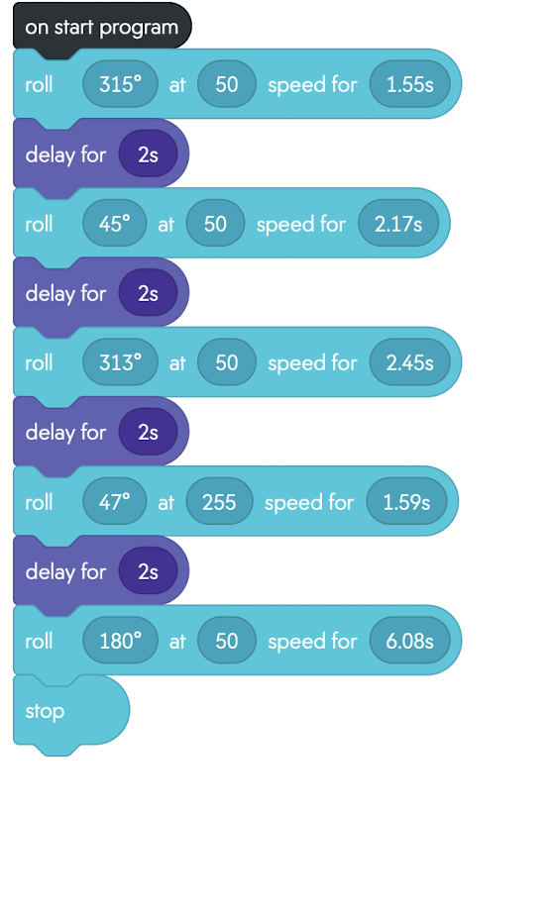
Sprint 3: Block Code

Slide 7
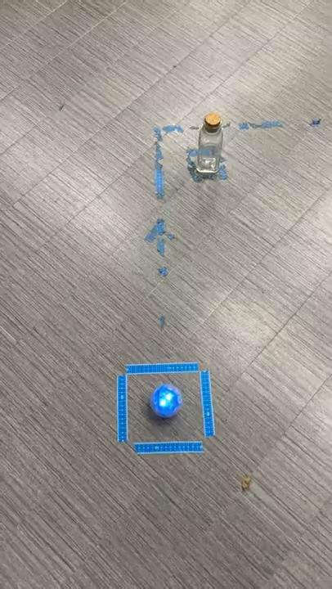
Sprint 3: Video

